Slide 1



Data Communication and Networks
Data Encoding and Communication Interface
Dr. Spoorthi P Shetty
Associate Professor
Department of MCA
NMAM Institute of Technology, Nitte (Deemed to be University)

Slide 2
Signal Representation
Digital Signal
• discrete, discontinuous voltage pulses
• each pulse is a signal element
• binary data encoded into signal elements.
• Text, integers
Analog Signal
• Signals which are continuous varying based on time.
• Example: Voice, video, voltage, pressure, etc
Reasons for Representation
• Digital data, Digital signal – less complex, less expensive
• Analog data, digital signal – modern digital transmission
• Digital data, analog signal - optical fiber, unguided media, propagate analog signal
• Analog data, analog signal - data in electrical form can be transmitted as signal
easily and cheaply.

Slide 3
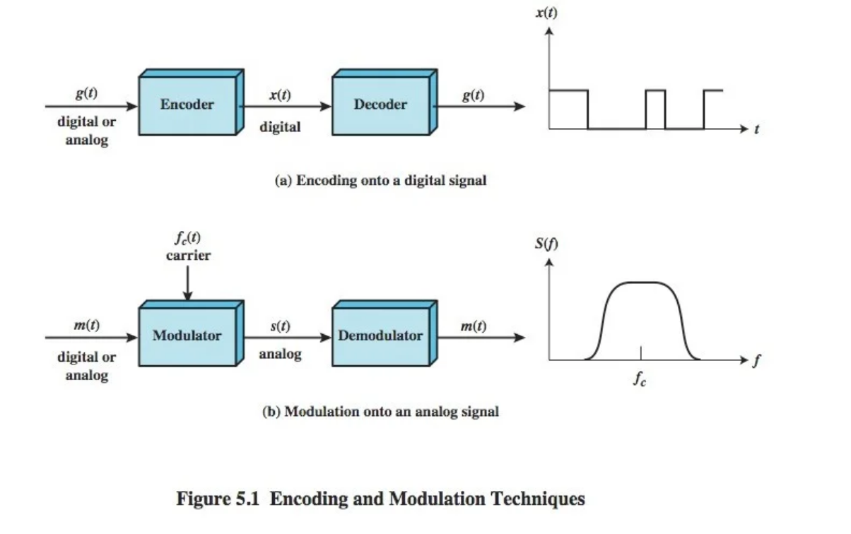
Signal Encoding Techniques

Slide 4











Terminologies
Unipolar — All signal elements of same sign (Either + or -)
Polar - one + voltage level, other - voltage level (different representation)
Data rate (R) - amount of data transfer during a specified time period over a network in bps.
Modulation rate - A measure of how many individual signal elements are transmitted per unit time.
Mark and space - 1 and 0 respectively
Signal to noise ratio – (increase in SNR, decrease in bit error rate)
Bandwidth – maximum amount of data transmitted over an internet connection in a given amount of time. (increase in bandwidth, increase data rate)
Signal spectrum - transfer power high at center, low at edges. Good signal design should concentrate on the transmission in middle of bandwidth.
Clocking - to know begin & end of bit position. (Provide separate clock both sides or provide synchronization)
Cost and complexity - higher signal rate to achieve high data rate increases cost.

Slide 5
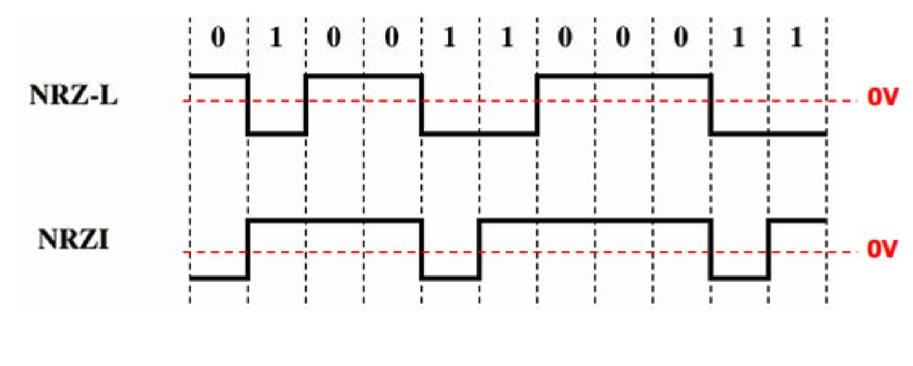
Digital data to Digital Signal-Nonreturn to Zero
Easiest way to transmit digital data to digital signal
2 types
NRZ-L (Nonreturn to Zero-Level)
0—high level
1—low level
NRZI (NonReturn to Zero Inverted)
0—No transition
1—Transition at the beginning of interval
Pros
• easy to engineer
• More reliable to detect a transition in presence of noise using NRZI
• make good use of bandwidth
Cons
• Presence of dc component
• lack of synchronization capability - when long string of 0’s and 1’s in NRZ-L and
long string of 0’s in NRZI
• used for magnetic recording
• not often used for signal transmission

Slide 6

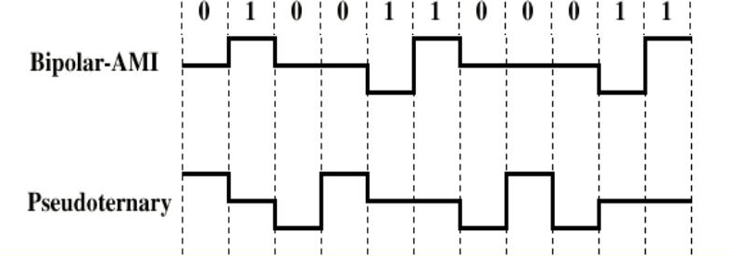
Multilevel Binary
Address the deficiencies of NRZ
Use more than two levels
2. Pseudoternary
1. Bipolar-AMI
• 0 – +/− level alternating for successive zeroes
• 0 – no line signal
• 1 – no line signal
• 1 – +/− level alternating for successive ones
Advantage :
• no loss of sync if a long string of 1’s occur
in Bipolar-AMI and 0’s in Pseudoternary
• easy error detection
Disadvantage :
• lack of synchronization when long runs of 0’s in Bipolar-AMI and 1’s in Pseudoternary
• Solution for this problem is: insert additional bits (scramble data)
• not as efficient as NRZ, because receiver distinguishes between three levels: +A, -A, 0

Slide 7

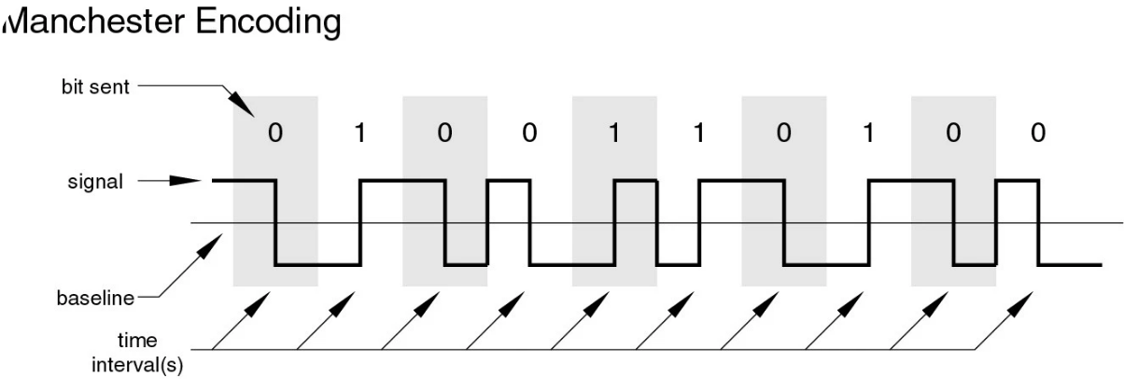
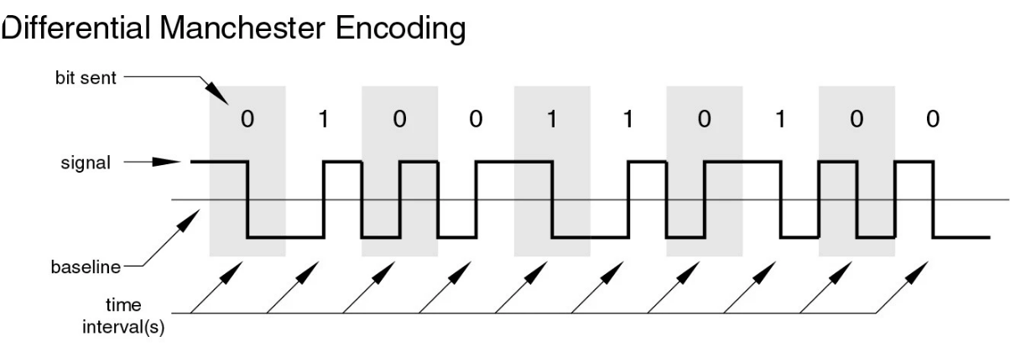
Biphase
2 types
Manchester
2. Differential Manchester Encoding
• has transition in middle of each bit period
• Always has transition in middle of each bit period
0—high to low
0—transition at start of bit period
1—low to high
1—no transition at start of bit period

Slide 8

Biphase Pros and Cons
Pros
• synchronization on mid bit transition (self clocking)
• has no dc component
• has error detection
Cons
• at least one transition per bit time and possibly two
• maximum modulation rate is twice NRZ
• requires more bandwidth

Slide 9
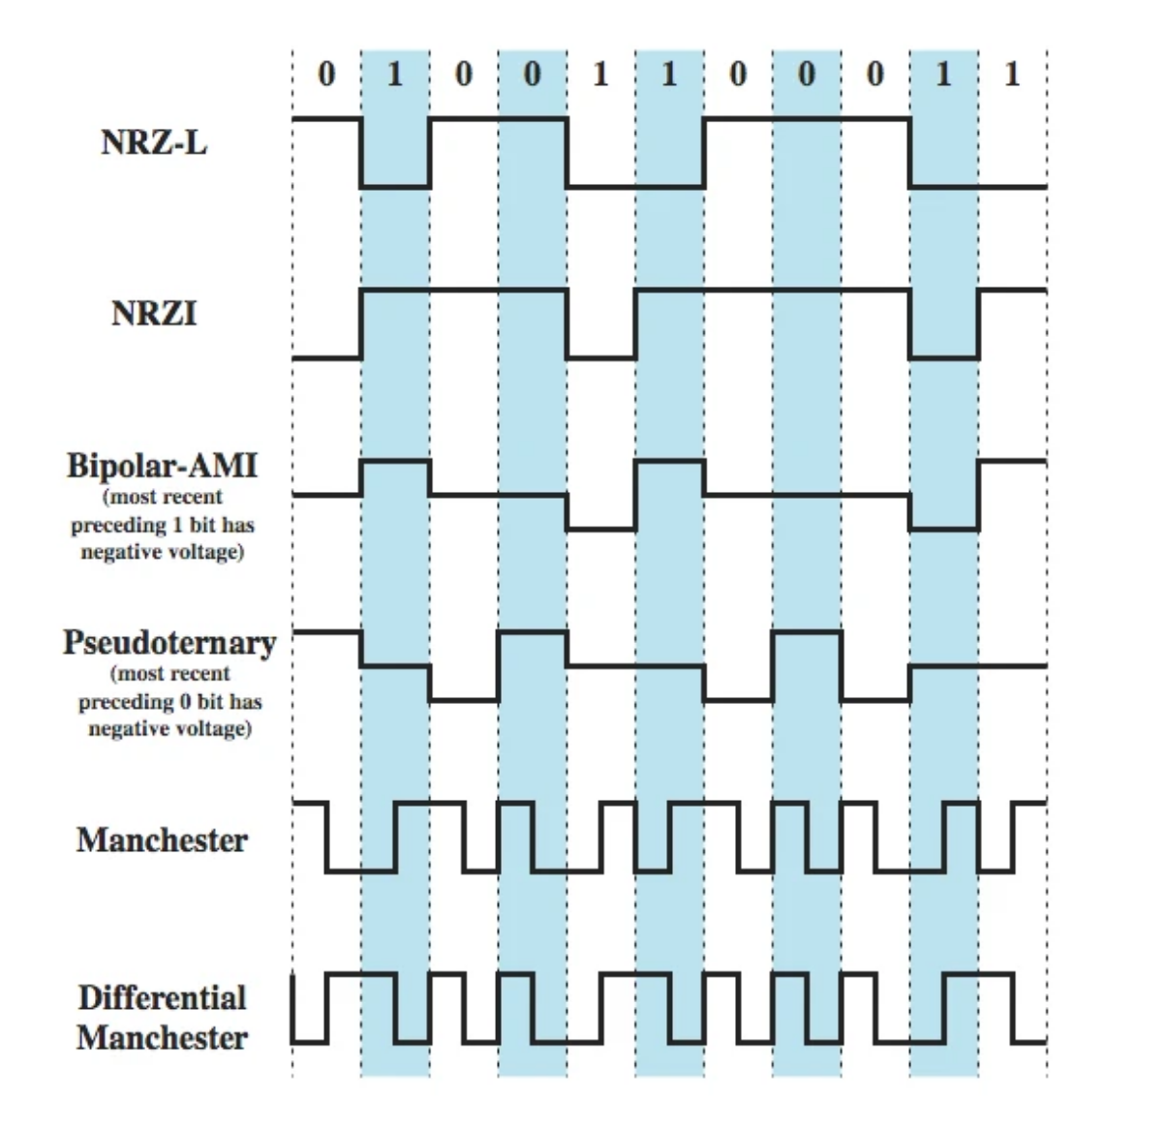
Encoding Schemes

Slide 10
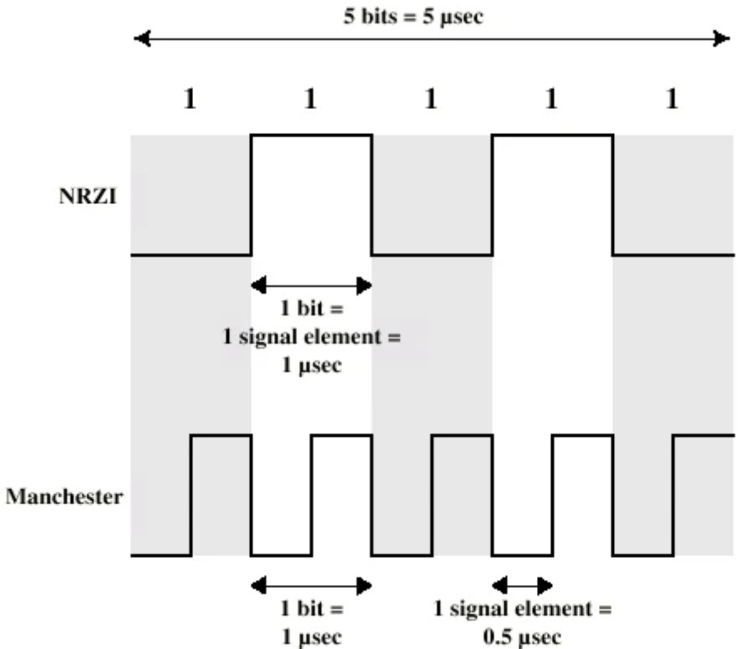
Modulation Rate

Slide 11

Scrambling Techniques
Biphase encoding requires higher bandwidth, whereas NRZ (Non-Return to Zero) encoding faces issues such as synchronization problems and the presence of a DC component.
In the case of Bipolar AMI (Alternate Mark Inversion), although it eliminates the DC component, long sequences of zeros can still lead to synchronization loss.
To address this, a technique called scrambling is used. Scrambling helps maintain synchronization without increasing the number of transmitted bits, making it an efficient solution.
There are two common scrambling techniques:
1. B8ZS (Bipolar with 8-zero substitution)
This technique is similar to Bipolar AMI except when eight consecutive zero-level voltages are encountered, they are
replaced by the sequence, “000VB0VB”.
Previous mark polarity | Encode
+ | 000+-0-+
- | 000-+0+-
V (Violation), is signal have same polarity as the previous non-zero voltage.
B (Bipolar) is signal have opposite polarity as the previous non-zero voltage.

Slide 12
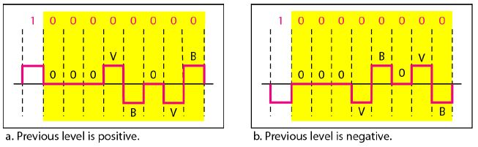
B8ZS (Bipolar with 8-zero substitution)
This technique is similar to Bipolar AMI except when eight consecutive zero-level voltages are encountered, they
are replaced by the sequence, “000VB0VB”.
V (Violation), is signal have same polarity as the previous non-zero voltage.
B (Bipolar) is signal have opposite polarity as the previous non-zero voltage.
Previous mark polarity | Encode
+ | 000+-0-+
- | 000-+0+-

Slide 13
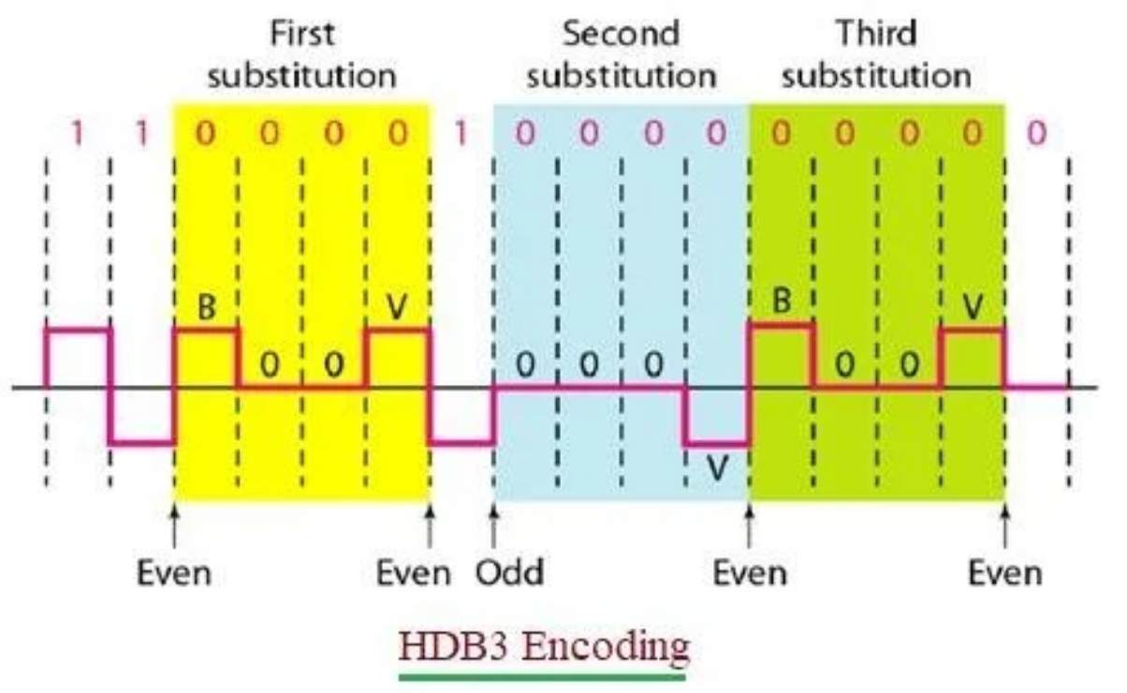
HDB3 (High-density bipolar3-zero)
Four consecutive zero-level voltages are replaced with a sequence “000V” or “B00V”.
If the number of nonzero pulses after the last substitution is odd, the substitution pattern will be “000V”, this helps maintaining total number of nonzero pulses even.
If the number of nonzero pulses after the last substitution is even, the substitution pattern will be “B00V”. Hence even number of nonzero pulses is maintained again.

Slide 14
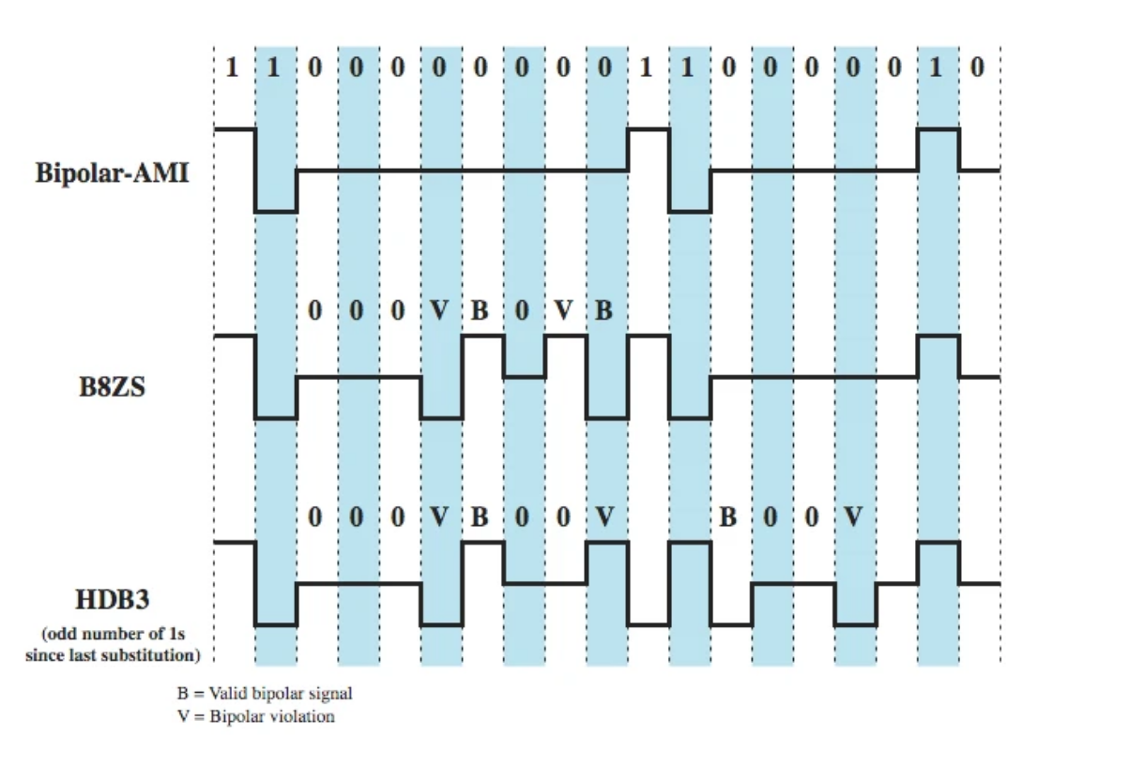
B8ZS and HDB3

Slide 15

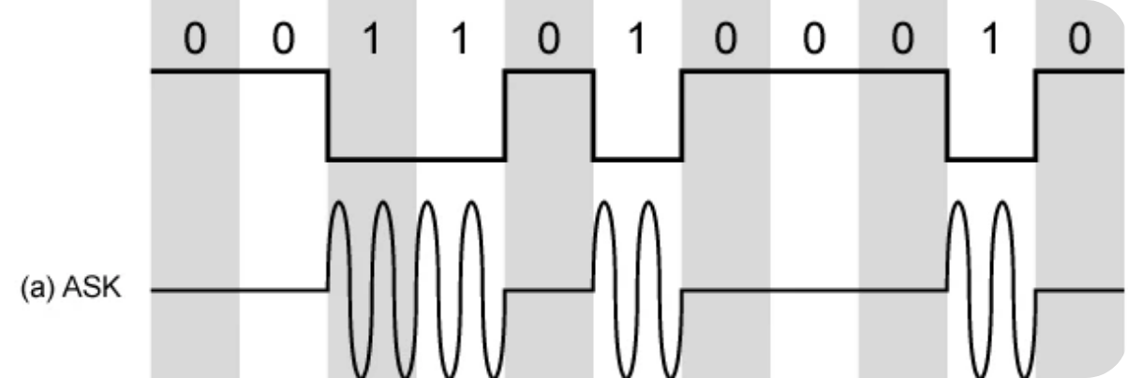
Digital Data, Analog Signal: Modulation Techniques
The main use is public telephone system
It has frequency range of 300Hz to 3400Hz use modem (modulator-demodulator)
Three types of Modulator techniques
1. Amplitude shift keying (ASK)
0/1 binary values represented by different carrier amplitudes
1—presence of carrier
0—absence of carrier
Example: LED – one- Presence of light, other- absence
Disadv: 1. inefficient
2. up to 1200bps on voice grade lines

Slide 16
2. Binary Frequency Shift Keying
Most common form of FSK is binary FSK (BFSK)
Two binary values represented by two different frequencies (near carrier frequency)
Less susceptible to error than ASK
Used for up to 1200bps on voice grade lines high frequency radio
More prone to error
Even higher frequency on LANs using coaxial cable
More bandwidth efficient

Slide 17


Phase Shift Keying
1
2
3
Phase of carrier signal
Binary PSK—two phases represent two binary digits
Differential PSK
• phase shifted relative to previous transmission rather than some reference signal
• 0 - signal with same phase as FSK
• 1 - signal with opposite phase to previous one
Quadrature PSK
• each signal element represents more than one bit
• To make efficient use of bandwidth, Uses phase shifts of u/2 (90°)

Slide 18
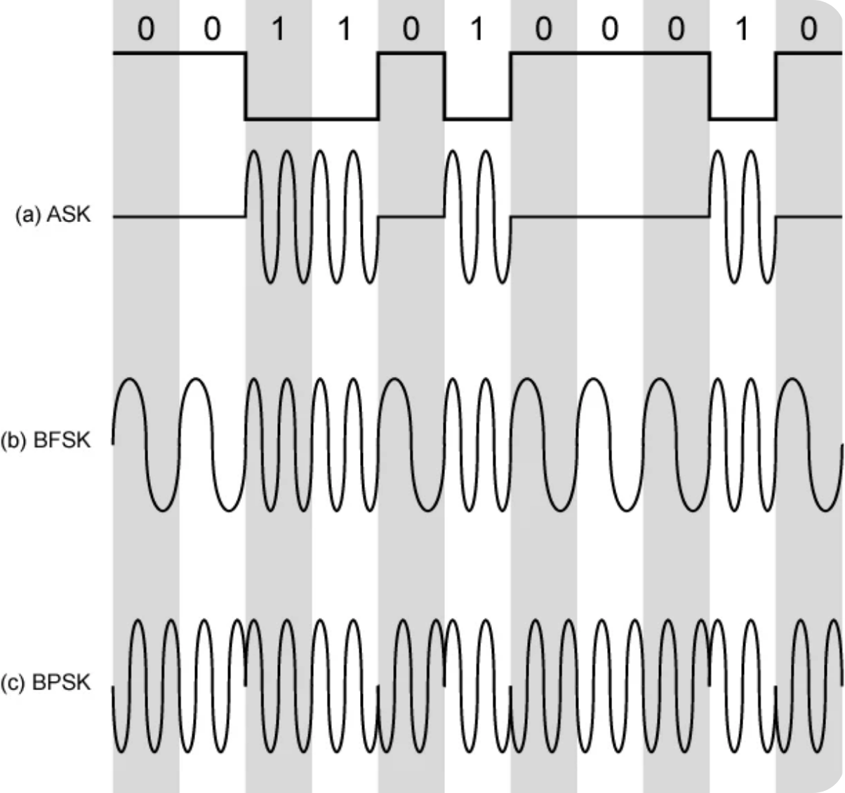
Representation of Modulation Techniques

Slide 19

Thank You

Slide 20
Data Communication and Networks
Data Encoding and Communication Interface
Dr. Spoorthi P Shetty
Associate Professor
Department of MCA
NMAM Institute of Technology, Nitte (Deemed to be University)

Slide 21


Analog Data, Digital Signal
Digitization is conversion of analog data into digital data
Digital data can be converted to digital signal using any techniques like NRZ, Biphase etc.
Digitizing Analog Data
Analog data to digital signal conversion is done using a codec device.
Techniques used are:
• Pulse code modulation
• Delta modulation

Slide 22

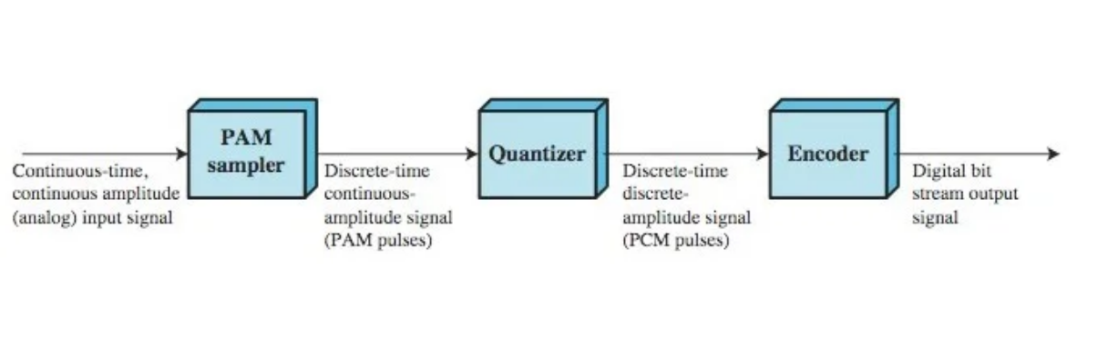
Pulse Code Modulation
Sampling
The analog signal is measured (sampled) at regular intervals.
According to the Nyquist Theorem, the sampling rate must be at least twice the highest frequency of the analog signal.

Slide 23

Quantization
Each sampled value is approximated to the nearest value within a finite range of levels.
This introduces quantization error.
Encoding
Each quantized value is then converted into a binary number (sequence of 0s and 1s).
These binary codes form the PCM signal.

Slide 24
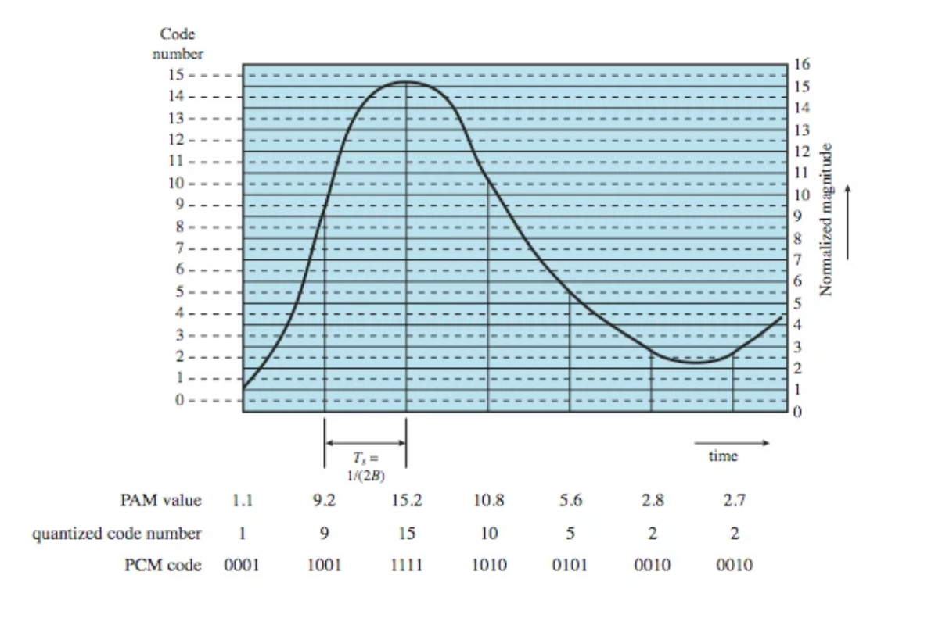
PCM Example

Slide 25
PCM Example Explanation
Bandlimited Signal: The original analog signal is assumed to have a bandwidth of B Hz.
Sampling Rate: According to Nyquist Theorem:
• Samples taken at 2B samples/second
• i.e., one sample every 1/(2B) seconds
Quantization Process: Each PAM (Pulse Amplitude Modulated) sample is quantized:
• Example: 16 levels ⇒ 4 bits per sample
• More levels = better approximation of original signal
Limitation:
• Quantized values are only approximations
• Exact recovery of original signal is not possible due to Quantization Error
• To improve quality-8-bit quantization can be used ⇒ 256 levels-Better approximation of original signal-but consumes more data rate.
Solutions to this problem are:
• Nonlinear Encoding
• Companding (Compressing + Expanding)

Slide 26
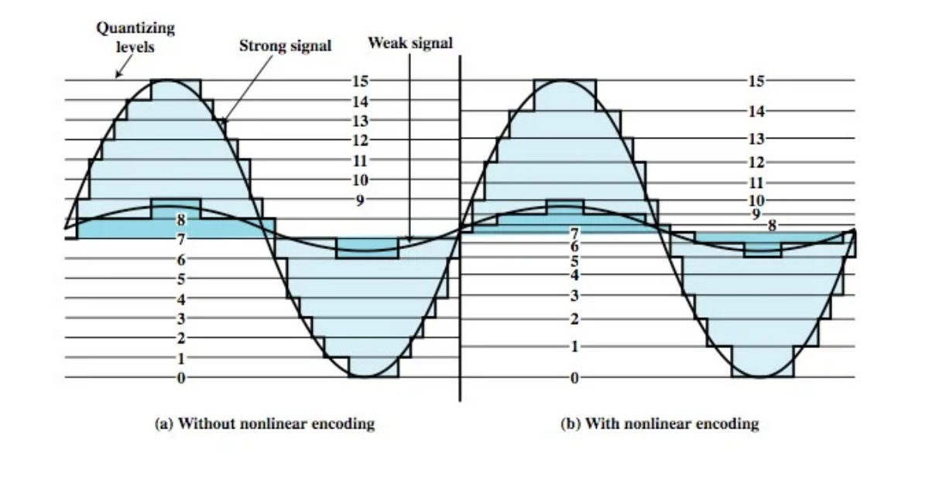
Nonlinear Encoding
Problem with Uniform Quantization:
• Equal spacing ⇒ equal error across all amplitudes
• Low amplitude signals suffer greater relative distortion
Solution:
• Use Nonlinear Quantization: More levels for low amplitudes
Fewer levels for high amplitudes
• Results in better overall signal quality

Slide 27

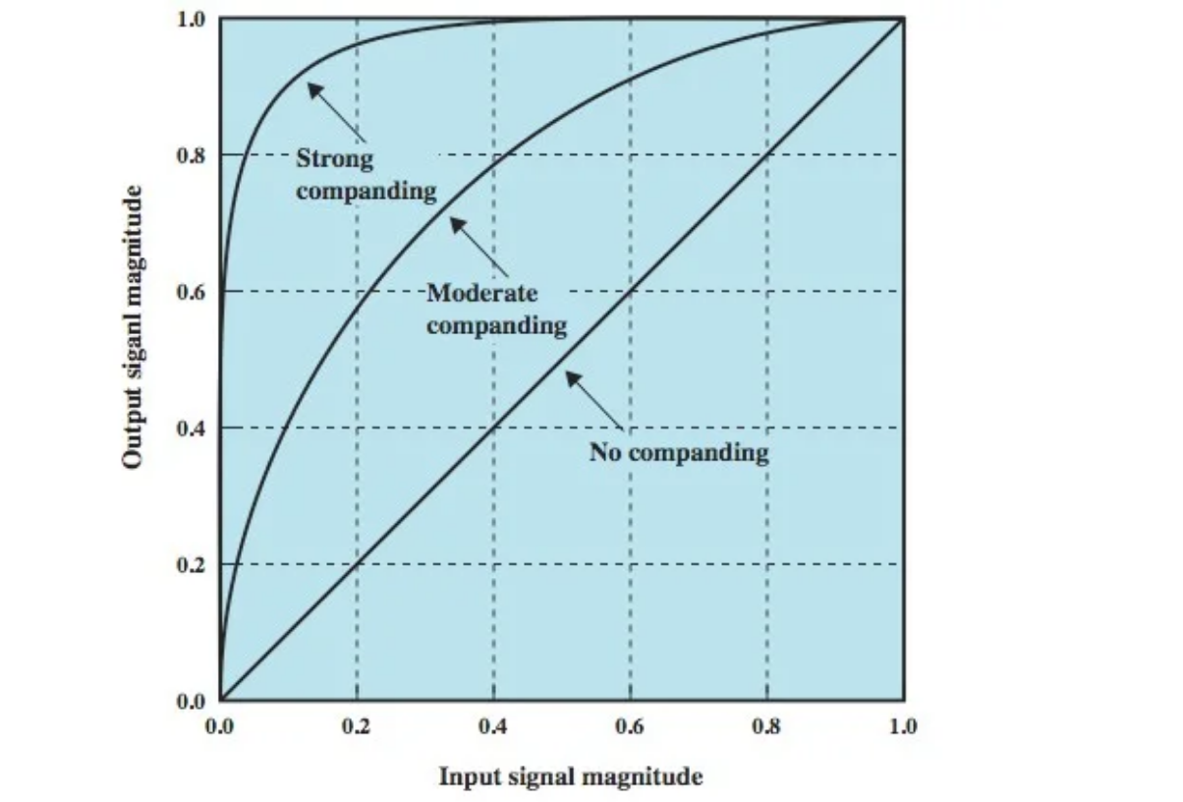
Companding
Alternative to nonlinear quantization
Applies uniform quantization but modifies signal range:
• Compression (at sender):
• Increases gain for weak signals
• Decreases gain for strong signals
• Expansion (at receiver):
• Restores original signal range

Slide 28

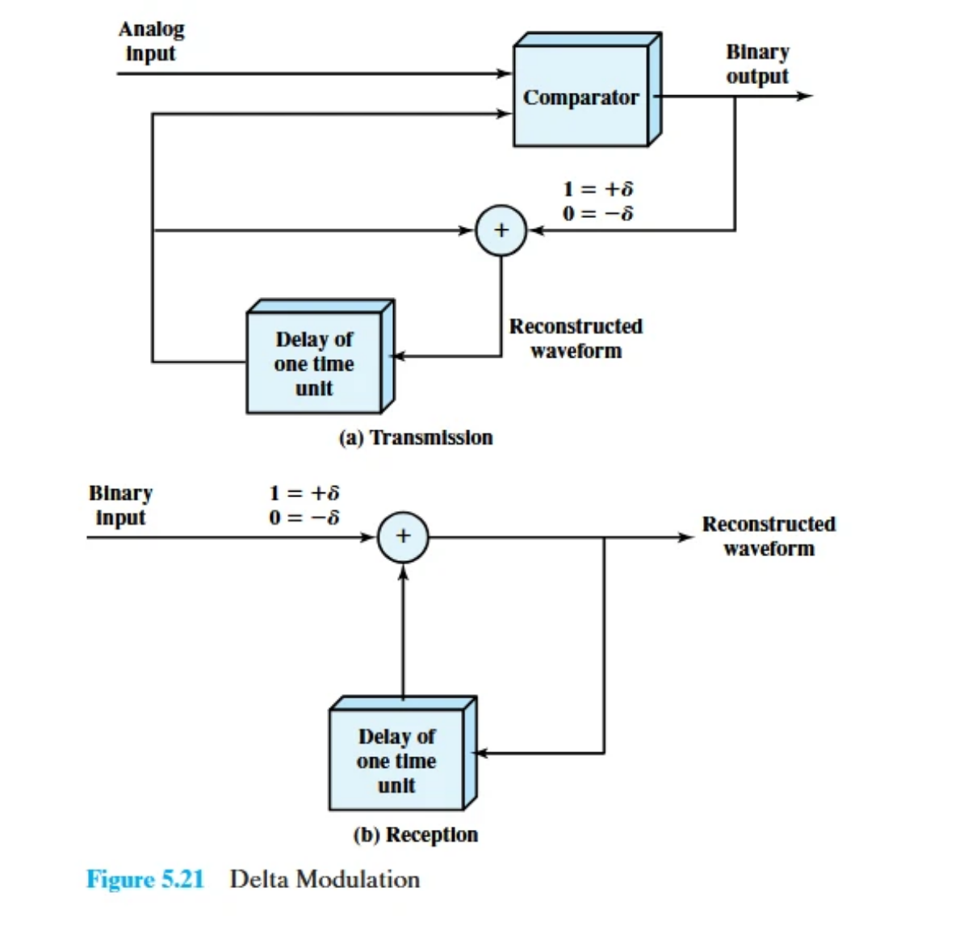

Delta Modulation
3
• 1 → Step up
• 0 → Step down
6
7
8
Steps:
Receiver reconstructs staircase from the bit stream
Output is smoothed using a lowpass filter
• At each sampling instant:
• Compare analog input to previous staircase value
• Generate 1 if input > staircase, else 0

Slide 29
Delta Modulation
1
2
3
4
5
A simplified alternative to PCM
Approximates an analog signal using a staircase function
The staircase steps up or down by a fixed amount (Δ) at each sampling interval
Tracks the change (derivative) in signal, not absolute amplitude
Requires only 1 bit per sample
• 0 → Step down
6
7
8
Steps:
Receiver reconstructs staircase from the bit stream
Output is smoothed using a lowpass filter
• At each sampling instant:
• Compare analog input to previous staircase value
• Generate 1 if input > staircase, else 0

Slide 30

Types of Error
Transmission errors can occur due to noise, interference, or attenuation.
Bit errors may lead to incorrect data interpretation.
Types of Error
Principle of Error Detection
• Frame: A contiguous block of bits transmitted together.
• Transmitter:
• Data (k bits) + Check bits (n - k) → Transmit n-bit frame
• Bit Error Rate (BER), Pb: Probability that a single bit is received in error.
• Receiver:
• Extract data and check bits
• Recompute check bits from received data
• Compare with received check bits
• Mismatch = Error detected

Slide 31
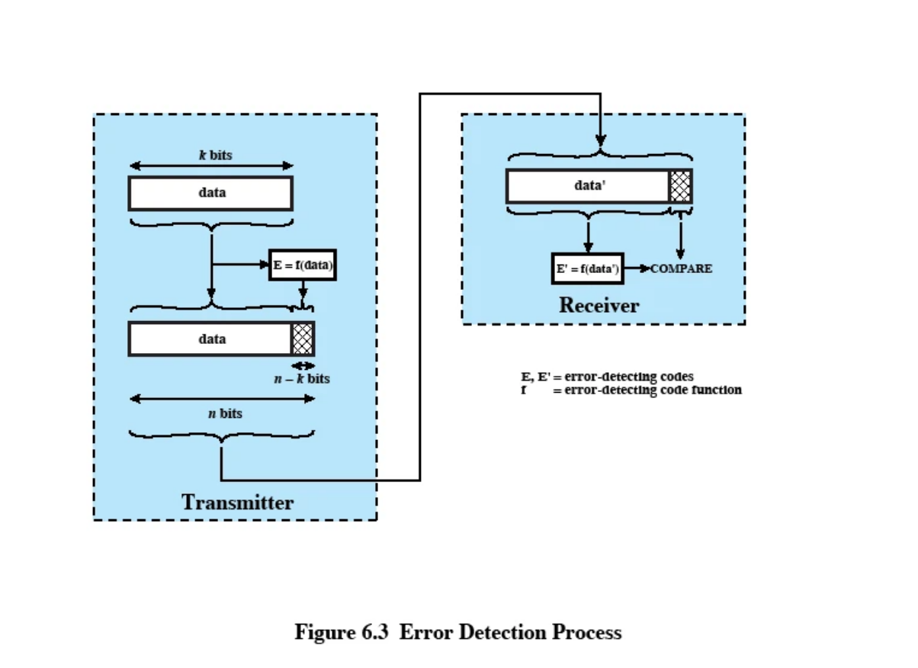
Error Detection Process

Slide 32
Parity Check
Parity Bit: A single bit added to a block of data (e.g., a character) to help detect errors.
Goal: Ensure the total number of 1s is either even or odd.
Odd Parity - Parity bit ensures odd number of 1s in data.
Even Parity - Parity bit ensures even number of 1s in data

Slide 33
Parity Check-Example for Odd Parity
• Character: G → Binary: 1110001 (7 bits) - total number of 1s in G are 4.
• Since odd parity, odd number of 1s required.
• Add a 1 as parity bit → 11110001 - Hence Transmitted byte: 11110001
• If total 1s remain odd → No error detected, else error detected.
Advantages
• Simple and Effective in detecting single-bit errors
Limitations
• Cannot detect even-numbered bit errors

Slide 34
Cyclic Redundancy Check (CRC)
One of the most common and powerful error detection methods.
3 Types
• Modulo-2 arithmetic
• Polynomial
• Digital logic
In Modulo-2 arithmetic and polynomial:
• for block of k bits, transmitter generates an n-k bit frame check sequence (FCS)
• Transmits n bits which is exactly divisible by some number
• Receiver divides frame by that number
• if no remainder, assume no error

Slide 35
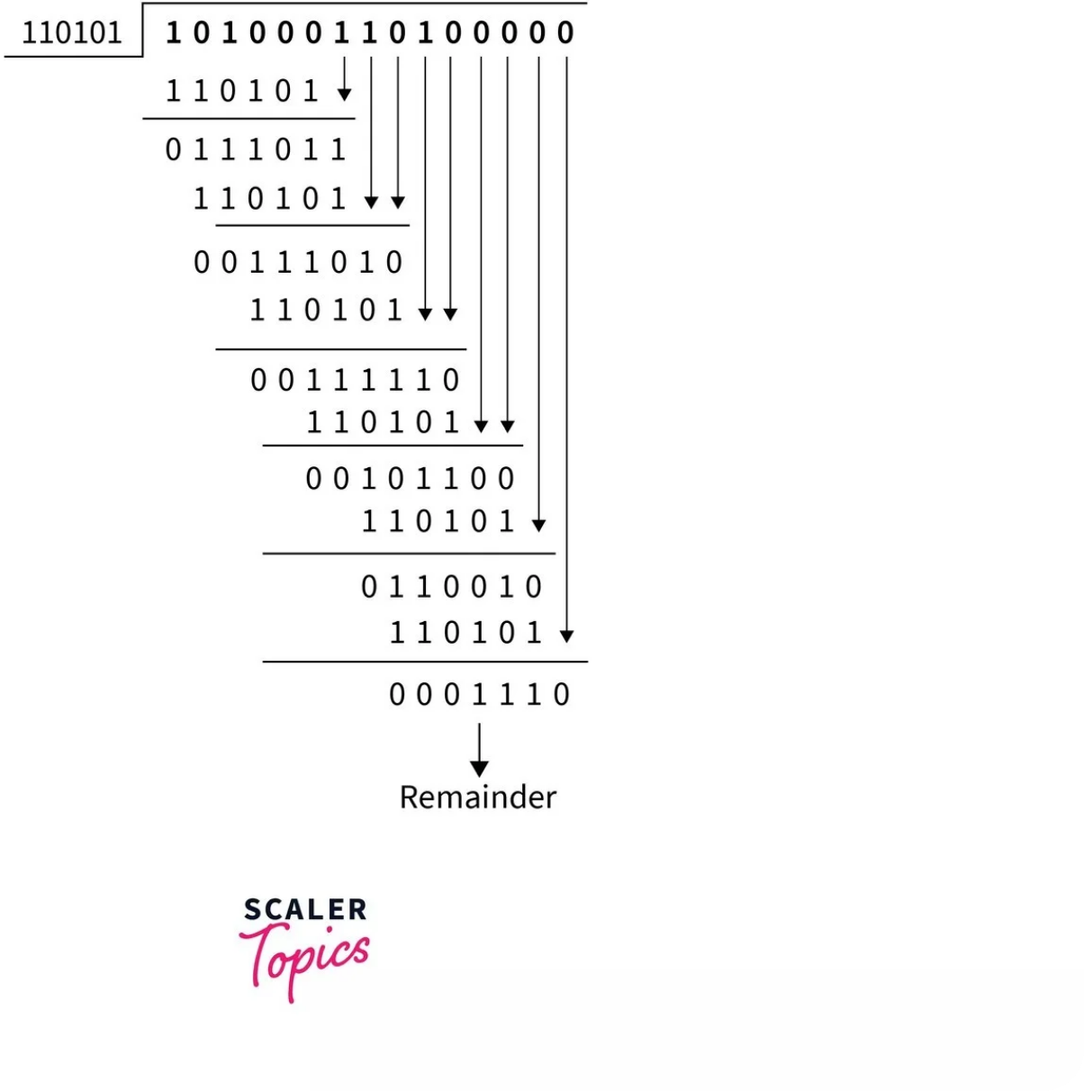


CRC Example
Consider the message sender wants to send is 1010001101, and the generator pattern is 110101. Find the message transmitted by the sender. If the receiver receives the message, check if the receiver receives the correct message or not.
.
Answer:
Step 1
Given
• M=1010001101=10 bits
• P=110101=x=6 bits.
• Hence number of bits in FCS=y=x-1=5 bits. Append 5 zeros to M
• 101000110100000, which makes Q.
Step 2
Now, let us divide Q by P and calculate the remainder by performing an XOR operation between bits.

Slide 36


CRC Step 3
Now, the remainder is then replaced with the appended number of 0 bits in Q.
The input stream will be changed to 1010001101 + 01110 (original input data stream + remainder) = 101000110101110.
Thus, this data is then transferred over the internet and is received by the receiver. In the next step, the receiver will check whether the received bits are correct or not using the same method which was used in Step 2.
CRC Step 4
In this step, now receiver will perform the following division to check whether the received data is correct or not.
After division if the remainder is zero, then there is no error during transmission. Else error occurred during transmission.

Slide 37
Thank You

Slide 38

CRC-Polynomial
Similar to modulo 2 arithmetic but representation using polynomial.
• Example:
• M = 1010001101 = X9 + X7 + X3 + X2 + 1,
• Pattern P = 110101 = X5 + X4 + X2 + 1

Slide 39
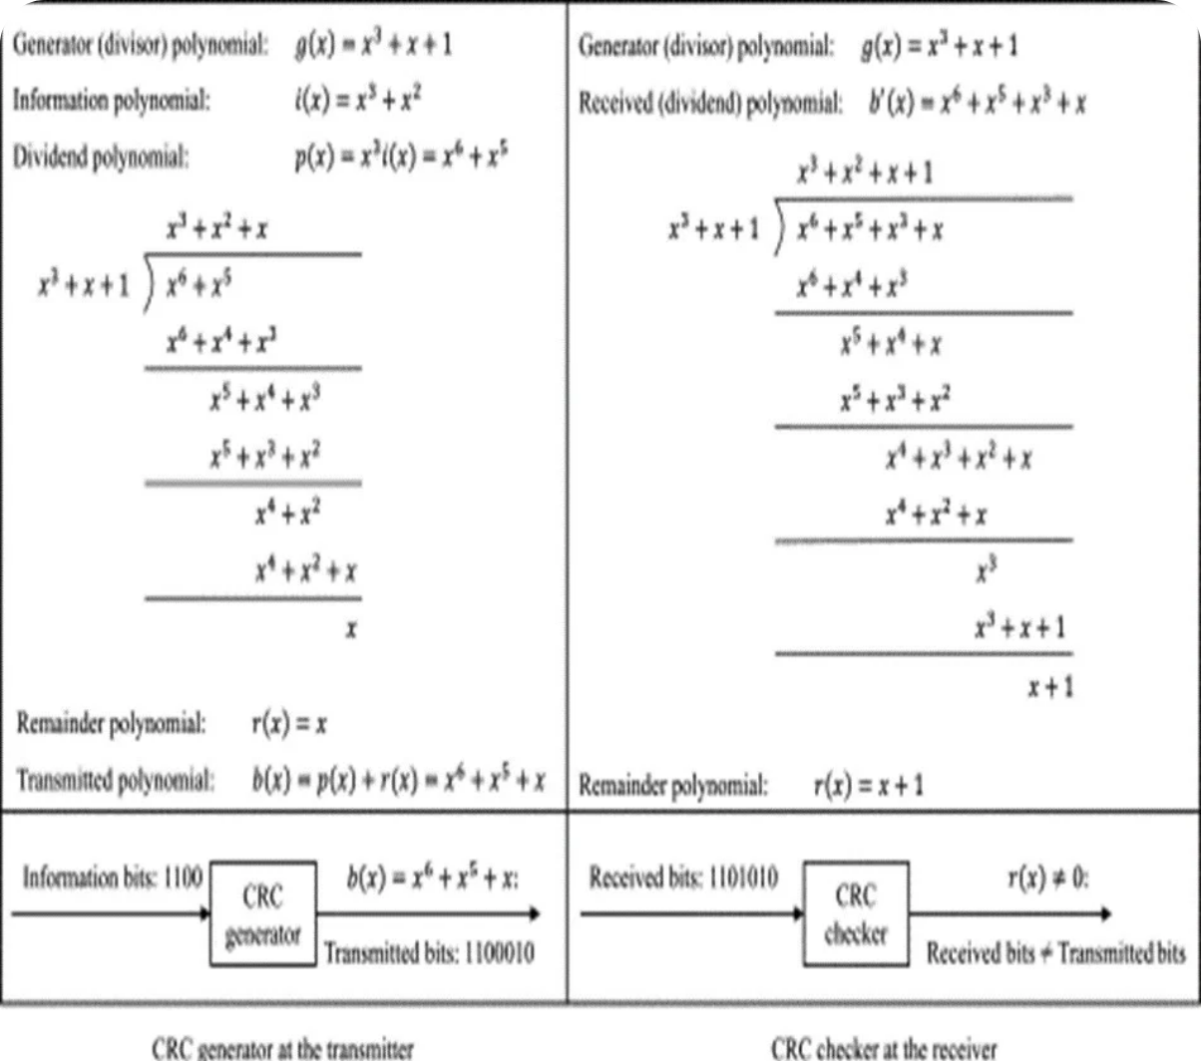
Polynomial
Question: Message is x3 + x2 and pattern P= x3 + x + 1. Find FCS using polynomial method and also check whether there is any error during transmission (introduce error in 4th bit position).
Answer:
M=4 bits P=4 bits hence FCS=3 bits
Q= Appending 3 bits to end of M, Q= X6 + X5

Slide 40
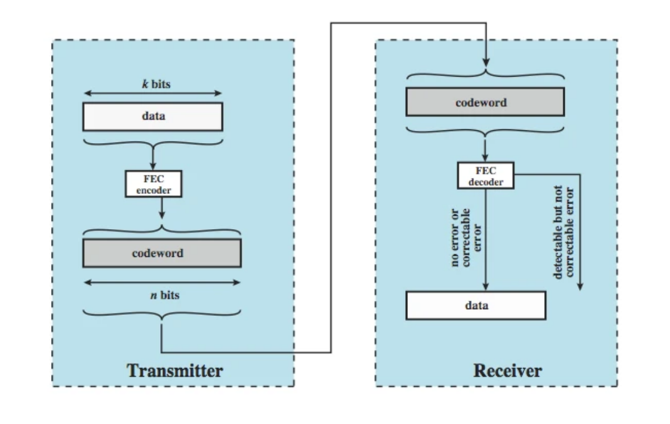
Forward Error Correction
Error Detection in Protocols
Widely used in:
• Data Link Layer: e.g., HDLC
• Transport Layer: e.g., TCP
Relies on retransmission when errors are detected.
Waste of bandwidth,
Instead need to correct errors on basis of bits received.

Slide 41
Thank You

